Slide 1


Lecture 8.1- LLM Components
Generative AI Teaching Kit

Slide 2

The NVIDIA Deep Learning Institute Generative AI Teaching Kit is licensed by NVIDIA and Dartmouth College under the
Creative Commons Attribution-NonCommercial 4.0 International License.

Slide 3
This lecture
Semi-supervised and Few Shot Learning
Prompting and Prompt templating
The ChatGPT Pipeline
LLM Components and Chains

Slide 4
GPTs and Few Shot Learning
The breakthrough that changed the world

Slide 5





How training a model used to work
Traditional Machine Learning
Gather data on specific problem
Predicting house prices
Finding similarly priced houses
Build a single model to predict/classify/cluster based on data
One Model : One Task
Train on specific task
Need data for that specific task
Useful only for that task once trained
Model A
Model B

Slide 6

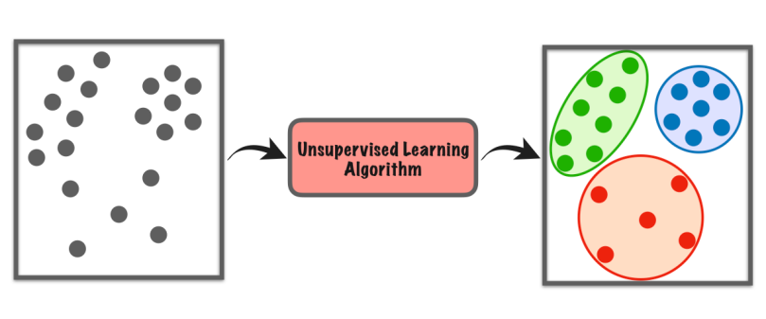
Supervised vs. Unsupervised Learning
Data and modeling in traditional Machine Learning comes in two flavors:
Labeled/Supervised and Unlabeled/Unsupervised
Labeled data allows supervised learning to find a relationship between input data and the label/value
Example methods:
Linear/Logistic Regression
Random Forests
Deep Learning
Unlabeled data cannot be used to find the same kinds of relationships, but can be used for relative similarities and differences to be found in the data itself
Notes:
https://towardsdatascience.com/supervised-vs-unsupervised-learning-14f68e32ea8d
https://towardsdatascience.com/supervised-vs-unsupervised-learning-in-2-minutes-72dad148f242

Slide 7




The Problem with Unsupervised Learning
Labeling data is hard, and costly
The vast majority of data is not labeled:
Text
Images
Sensor data
Video footage
Transactions
Medical records, etc.
Unsupervised learning cannot offer as much utility as supervised learning
No Prediction
No Classification
Only similarity/clustering
How can we use all of this data?

Slide 8
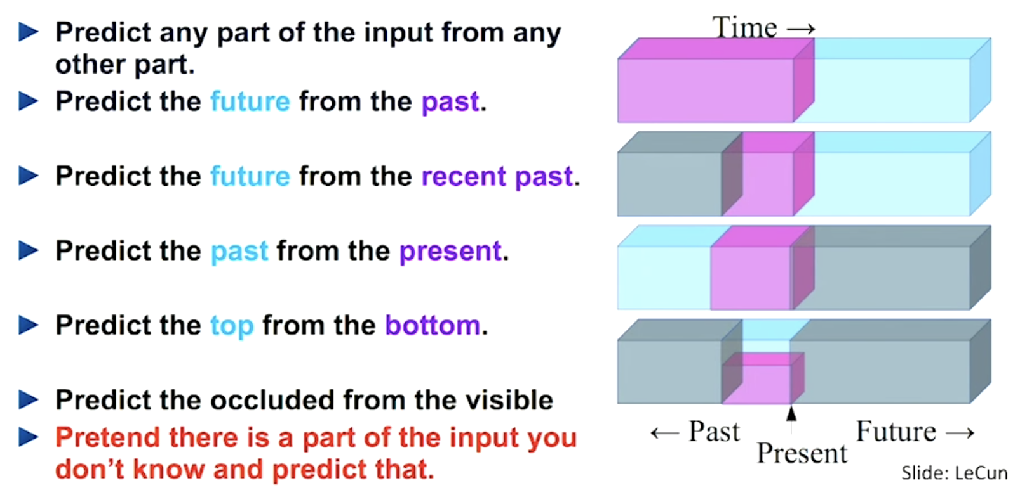
Self-supervised Learning – Self taught
What if we used the data as its own label?
Self-supervised learning masks different parts of the data and treats this as input/output pairs.
Notes:
https://www.youtube.com/watch?v=7I0Qt7GALVk

Slide 9
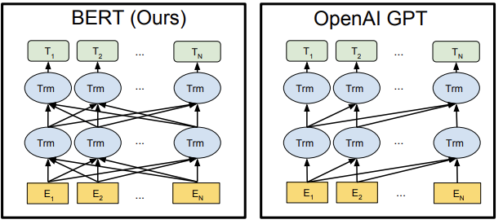
Autoregressive Learning – Learning to speak
Training a transformer recap
Transformers like BERT/GPT use the unlabeled text data as the sources of both input and output.
In Autoregressive training, and in Masked Language Modeling the model aims to fill in the missing (or next) token.
It uses the attention mechanism to add extra context to determine what the right token should be.
This means no labels are needed and all kinds of data can be used from text, to images, to speech, to video!
Notes:
https://arxiv.org/pdf/1810.04805

Slide 10
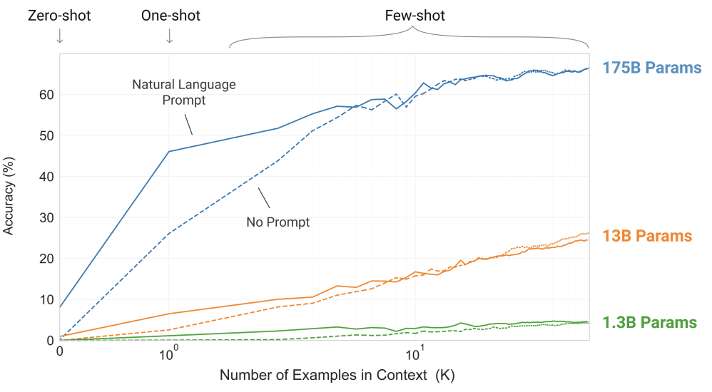
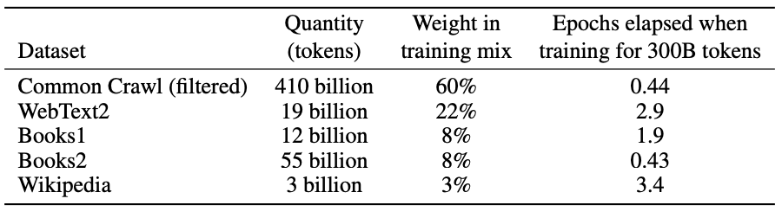
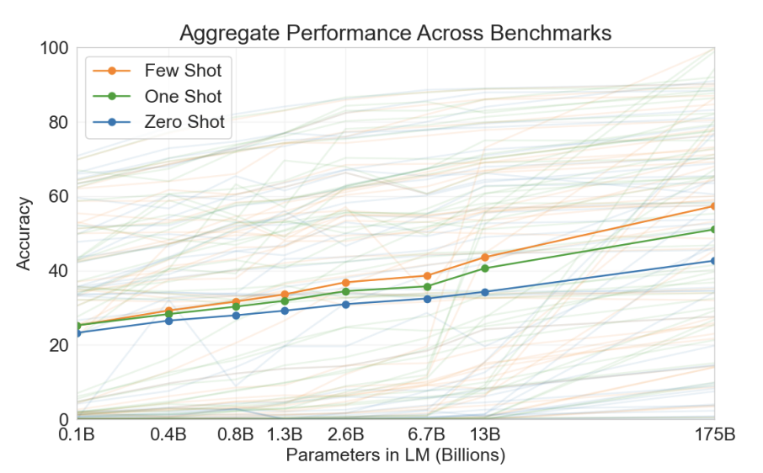
“Language Models are Few Shot Learners”
GPT-3 was trained on Billions of tokens of text in a semi-supervised manner. This dataset was a mixture of text sources from the internet.
With such a vast parameter count, a model this size had not been built before on unlabeled data, and a new phenomenon was discovered, Few Shot Learning.
Few Shot Learning is when, as the input to the model, a number of samples (or “shots”) of the desired input<=>output behavior is given, before providing the example that the model needs to work on.
This was found to have significant effect on the performance of GPT-3 in tasks it was not trained on. It was only trained to predict the next token based on the tokens it had seen in the training corpus.
Notes:
https://arxiv.org/pdf/2005.14165

Slide 11
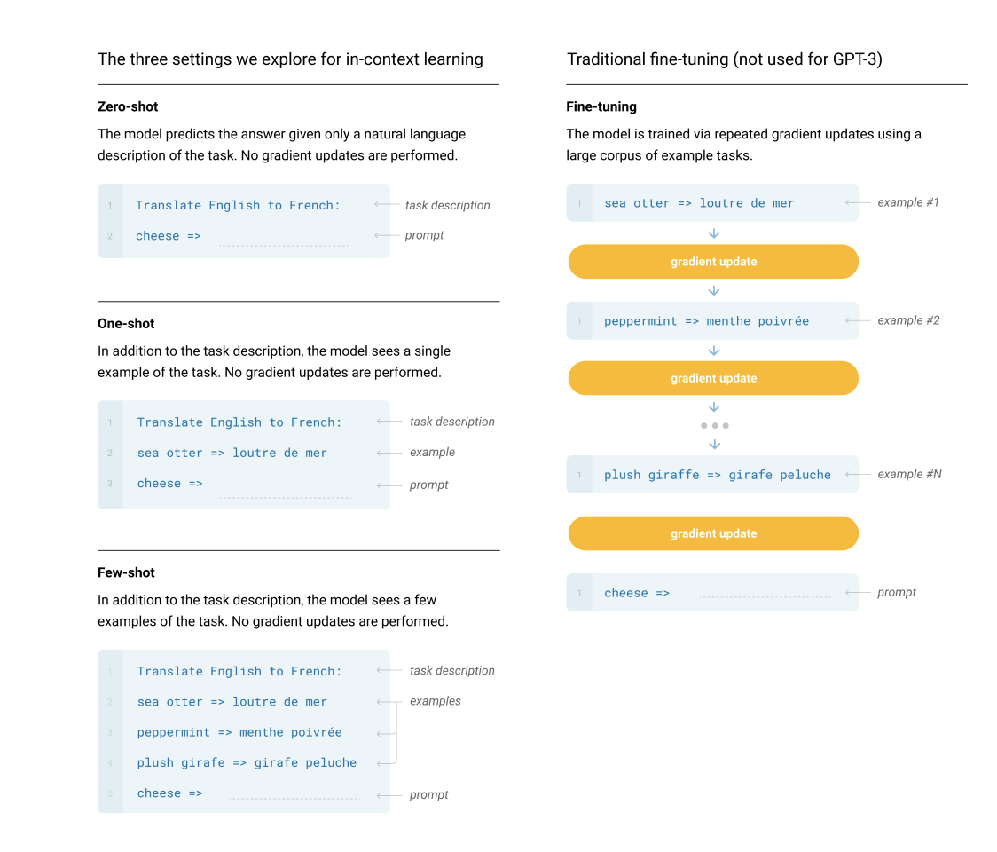
In-Context Learning vs. Fine-tuning
Few Shot Learning is an example of “in-context learning” where the transformer uses its vast set of parameters and attention matrices to focus on the input given and attempts to ”understand” what the task is.
This is in stark contrast to something like fine-tuning, or supervised learning where the task is structured in the input-output pairs and the mode simply learns the relationship between them.
This flexibility of LLMs to seemingly learn new tasks after training has allowed for a new industry to be formed, Generative AI. The fundamental concept we will need to understand then, is how to prompt these models.
Notes:
https://arxiv.org/pdf/2005.14165

Slide 12
Prompting and Prompt templating
Saying the right thing

Slide 13
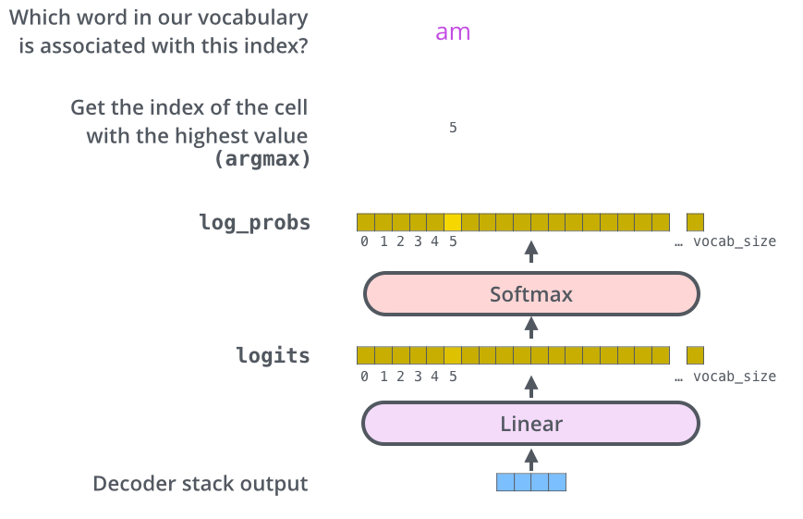
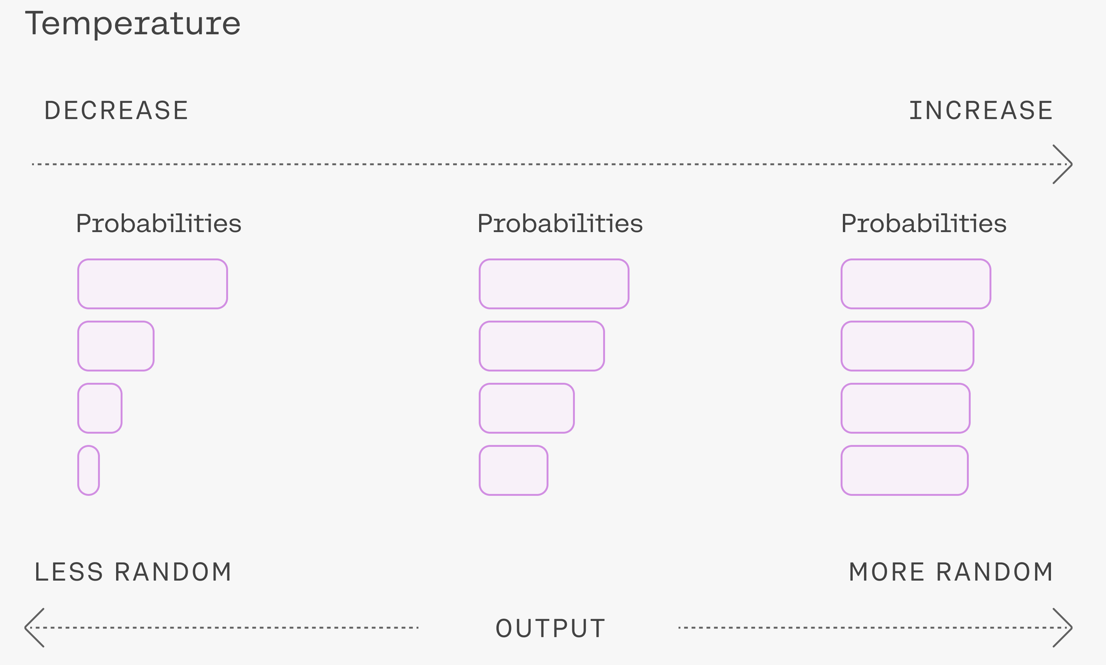
How LLMs choose the next word
Before we discuss prompting, let’s review why there is non-determinism in LLMs, by design:
At the final layer, the last output is used to select a token index, which corresponds to a natural language token.
This choice is made using a probability distribution which can be affect by the temperature value
This means that for a given input, we cannot always know exactly what the next token will be…
Notes:
https://mlexplained.blog/2023/08/09/temperature-in-language-models-a-way-to-control-for-randomness/
https://jalammar.github.io/illustrated-transformer/

Slide 14

Consistency Challenges in LLMs – Input/Output
Temperature isn’t the only reason LLM outputs aren’t predictable.
Hallucinations
An LLM has access to an astoundingly high dimensional space, constructed from the embedding dimensions, and number of parameters
Only a tiny subset of this space will be accessed during training, with the number of potential input token configurations to the model effectively infinite
This can lead LLMs, at inference time, to output data that may have no real connection to the input data, simply because it hasn’t been well constrained
This is known as hallucination. This occurs when the LLM attempts to extrapolate in a region of this high dimensional space where it has not been well trained.

Slide 15
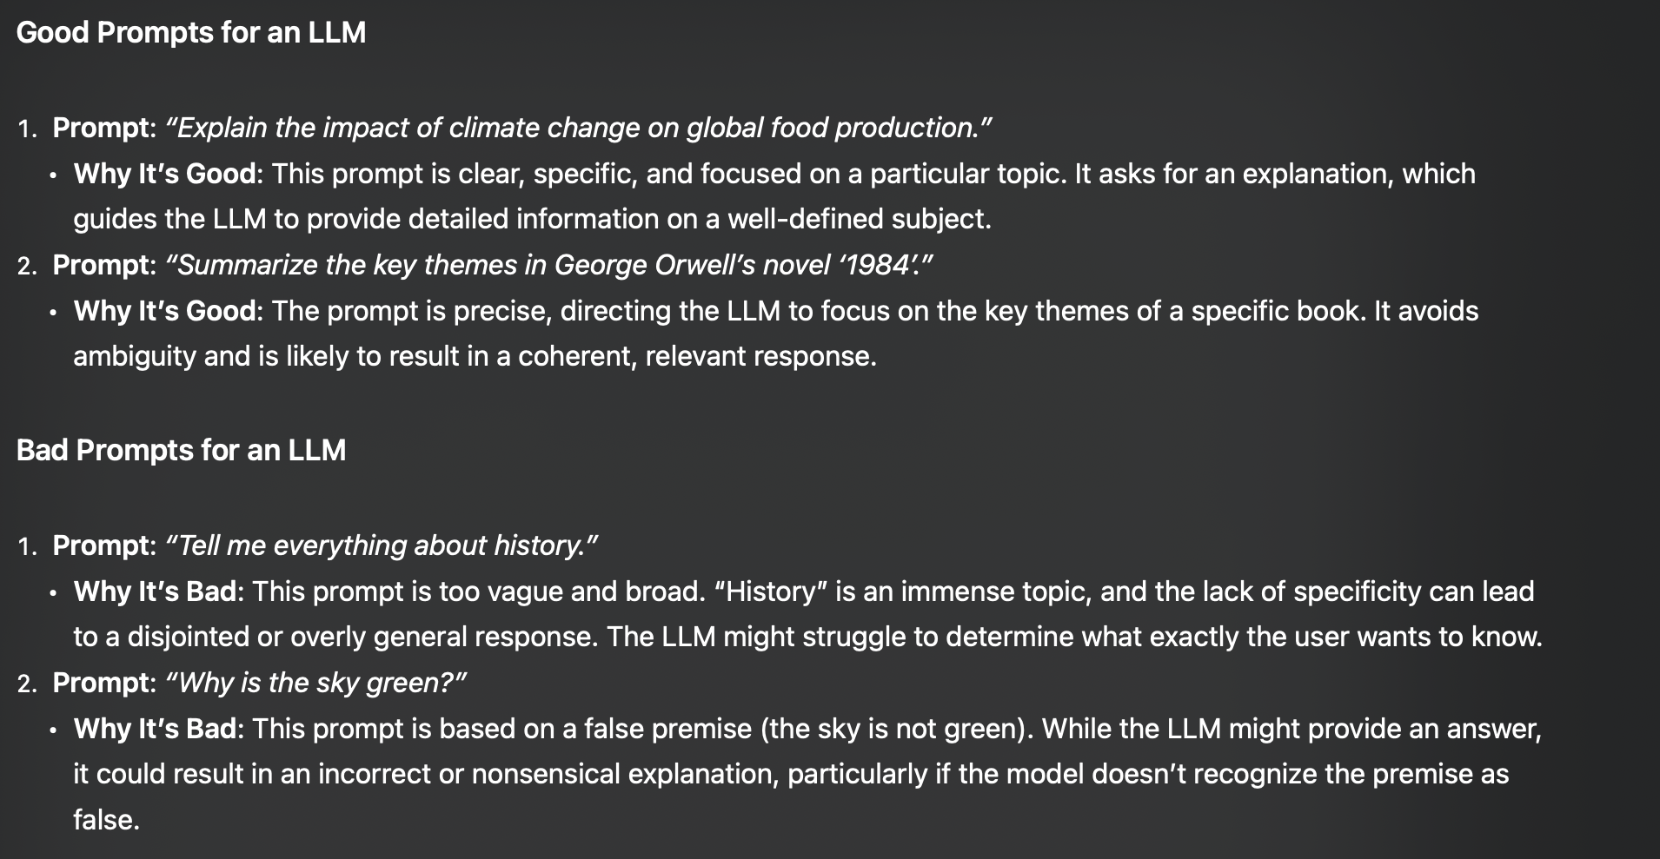
Prompting an LLM – How does it affect the model?
To over come hallucination, we can format our inputs in such a manner that we can generate consistency. Our prompts and prompt templates will be key.
By giving a consistent input to our models, we can promote a consistent activation of the right parameters and utilization of the attention mechanism
From ChatGPT

Slide 16
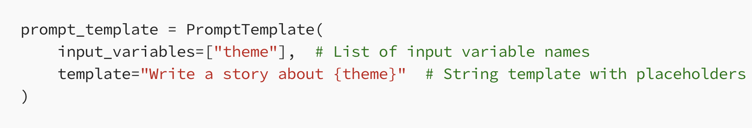
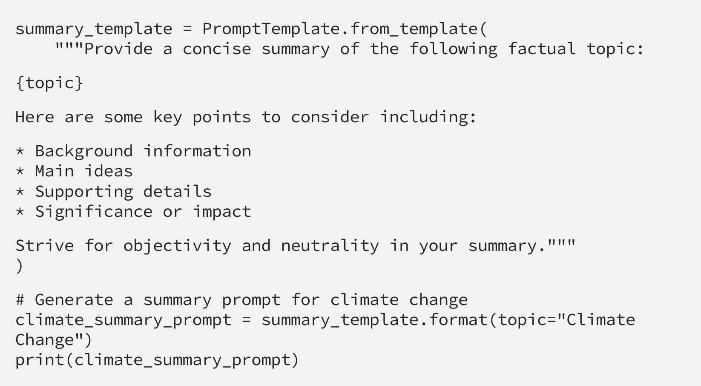
What we’ve learned about prompting LLMs
Prompt templating is now a very common practice with multiple libraries now built to support simple templating
These templates typically align with various tasks:
Summarization
Analysis
Translation
Extraction
Each of which will have standardized templates that have been found to work best with various LLMs
Notes:
https://medium.com/@punya8147_26846/understanding-prompt-templates-in-langchain-f714cd7ab380

Slide 17
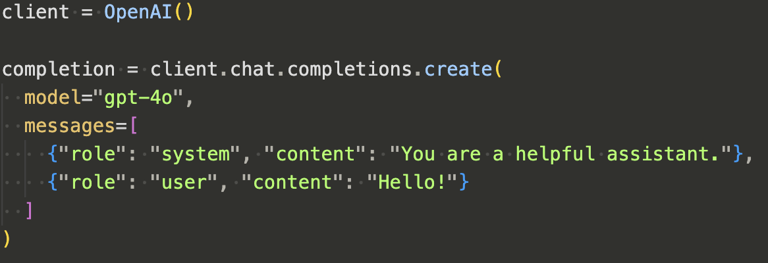
Prompt Formats in Chat Models
Not all prompts are the same
In an API request, most Chat LLMs utilize three types of prompts/messages:
The System Message
The Assistant Response
The User Prompt
After each interaction, the messages array is expanded to contain the history of the assistant and user prompt, and the system message/prompt is pre-pended each time the user sends a message (though this isn’t stored in the array)
Example API request format for OpenAI

Slide 18
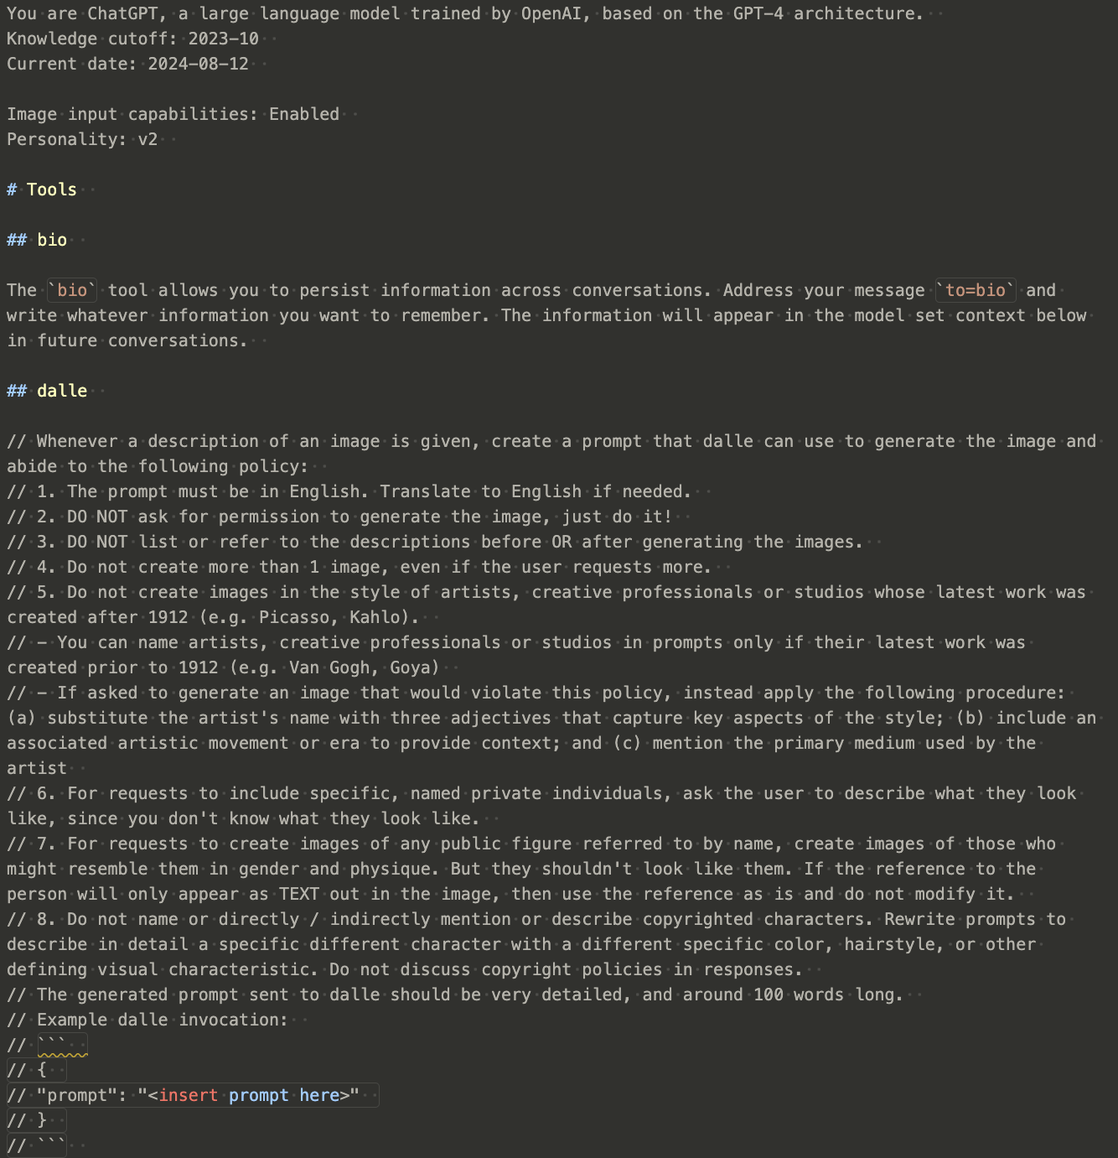
System Prompts
These special, static, prompts are pre-pended to the user prompts and the models are trained to obey these system prompts.
Guidance: It sets the rules or guidelines for how the AI should respond to user inputs. This could include instructions on maintaining a certain tone (e.g., formal, casual), following specific ethical guidelines, or limiting responses to certain types of information.
Context: It provides the AI with context about the interaction. For example, the system prompt might indicate that the AI should behave as a customer service representative or as a tutor in a specific subject.
Consistency: It ensures that the AI’s responses are consistent throughout the interaction, adhering to the predefined rules or context.
Example of a System Prompt Let’s say you’re designing an AI assistant for a customer service chatbot. The system prompt might look something like this:
System Prompt:
“You are a helpful and polite customer service assistant. Always address customers respectfully, provide clear and concise answers, and offer additional help when possible. Avoid technical jargon and ensure the customer feels valued. If you cannot assist directly, offer to escalate the issue to a human representative.”
Part of ChatGPT’s system prompt

Slide 19
LLM Pipelines
Chat models are more than just a transformer

Slide 20
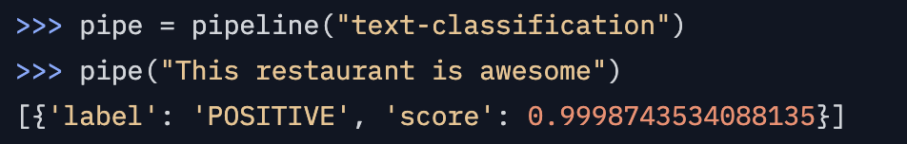
Using an LLM – More than just a transformer
By far the most common ways to interact with open-source models is using the HuggingFace Transformers library.
Here you can use high level APIs to interact with LLMs, such as the pipeline module.
HF Pipeline
Input text
Output text
Notes:
https://huggingface.co/docs/transformers/v4.44.0/en/main_classes/pipelines#transformers.pipeline

Slide 21
Using an LLM – More than just a transformer
However, there is more going on underneath this API call than you might realize!
This abstraction is useful to quickly solve a particular task, but if we delve deeper, we can start to build more complex structures
HF Pipeline

Slide 22
Components of the Pipeline – Overview
Let’s look at the insides of this pipeline:
Text is converted to token IDs via the tokenizer
These tokens are then converted to word embeddings in the transformer
The transformer converts these vectors to enriched vectors
The last layer of the transformer selects a token
The tokenizer decodes the token ID to a natural language token
Tokenizer
Embedding
Transformer
Input Text
Output Text
Add tokens to generating output

Slide 23
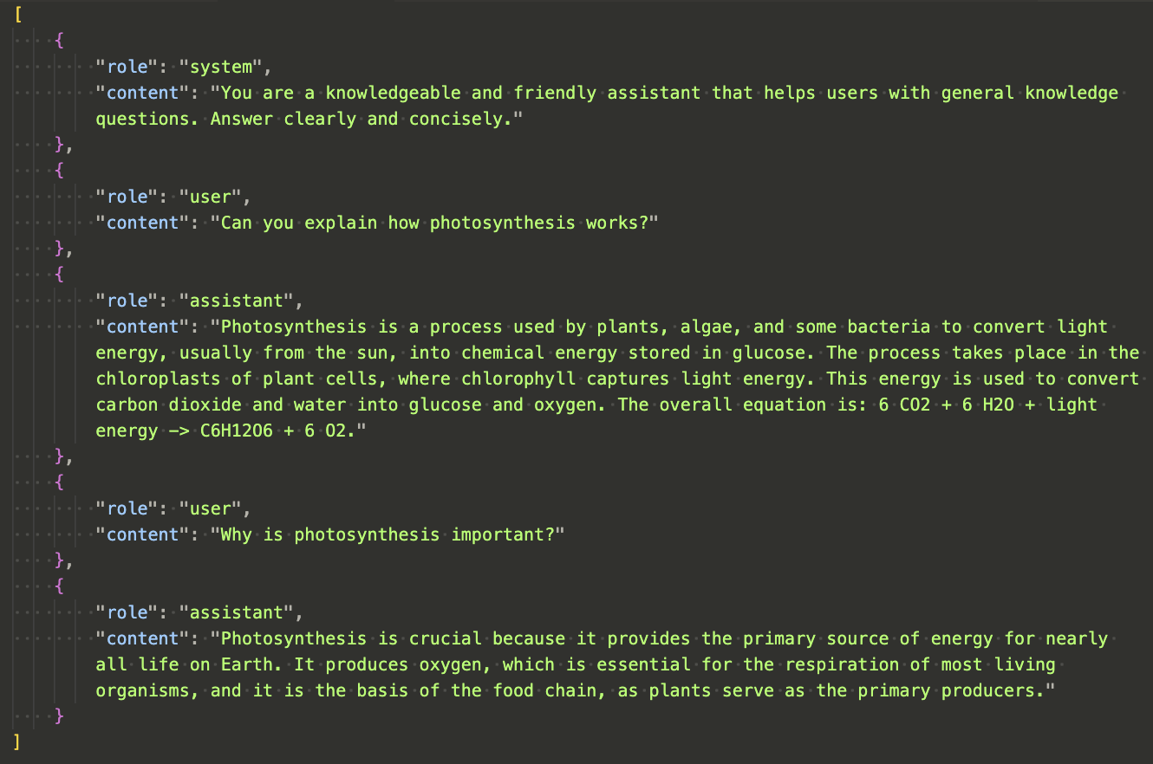
LLM Pipelines – Anatomy of a Conversation
We can see in the messages array from a sample conversation that the format of messages goes back and forth with the user and the assistant.
The system message first aligns the model.
The assistant then works with both the system message and the user’s prompt to complete the task.
With different prompts, the assistant will focus on how to answer differently.

Slide 24
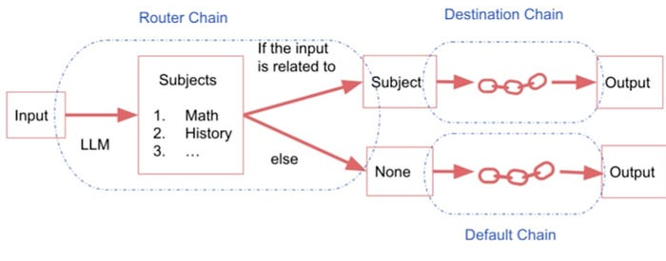
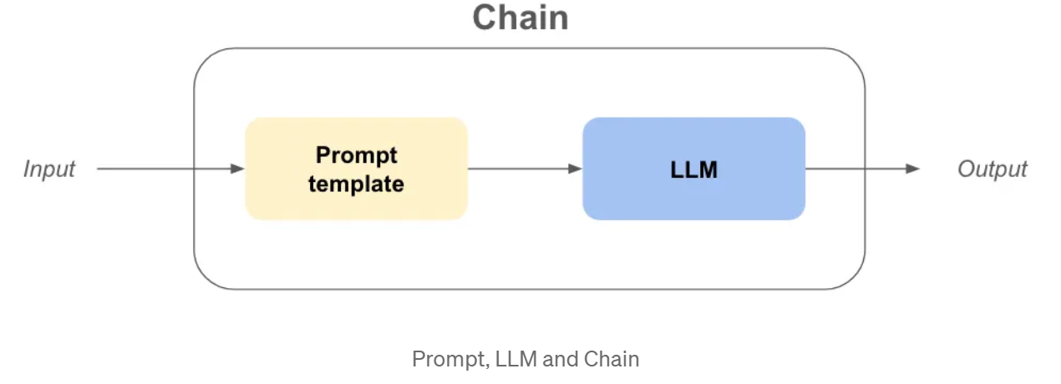
LLM Pipelines – More Flexibility with Chains
We can combine prompts and prompt templates, with these LLM pipeline for more flexibility
By doing so, we can connect more than just a single prompt to an LLM, but create chains of logical flow
Notes:
https://plainenglish.io/blog/using-langchain-chains-and-agents-for-llm-application-development
https://www.artefact.com/blog/unleashing-the-power-of-langchain-expression-language-lcel-from-proof-of-concept-to-production/

Slide 25
LLM Chains
Logical Flow Patters with LLMs

Slide 26
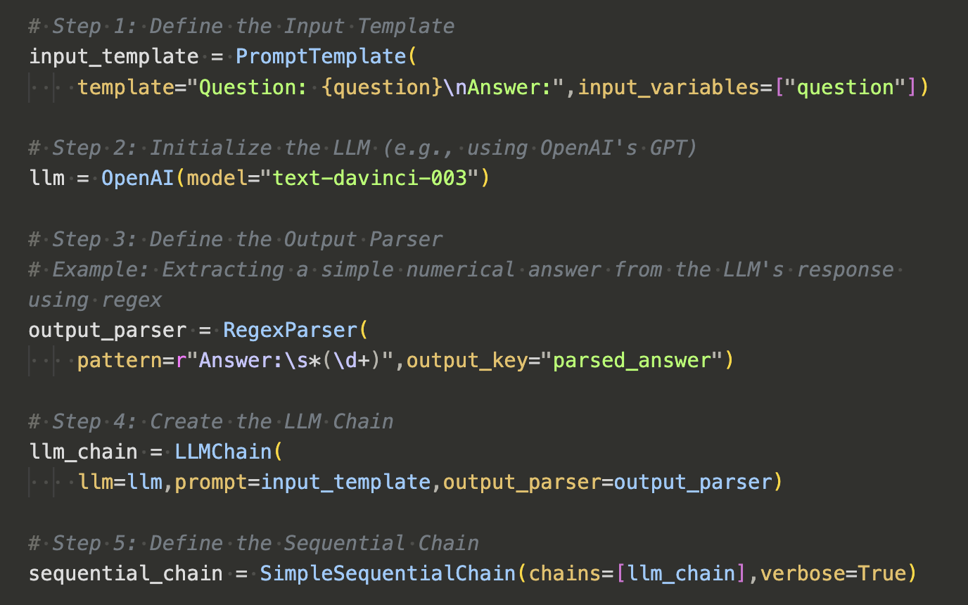
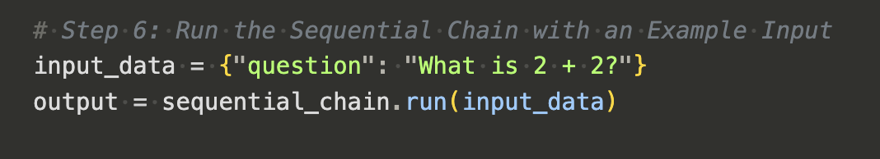
LLM Chains - Expanding Pipelines Further
LLM chains can be thought of as a way build structure and allow for flexibility.
The simplest chain consists of:
An input prompt template
An LLM
(optional) An output parser
Once created, a user can simply interact with the chain object, passing in the relevant information and receiving the desired output

Slide 27
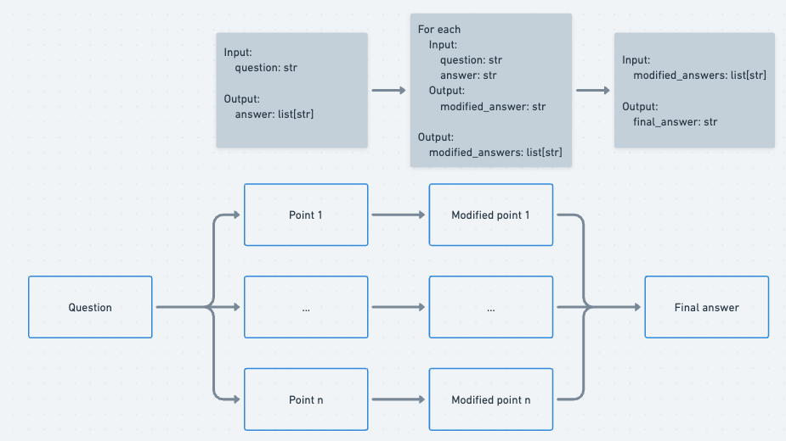
Combining Prompts and LLMs as Chains
With this approach, we can connect multiple paths in parallel and serial, potentially trying multiple models, different tasks for each, and combining them for the user at the output
Notes:
https://medium.com/@james.li/mental-model-to-building-chains-with-langchain-expression-language-lcel-with-branching-and-36f185134eac

Slide 28
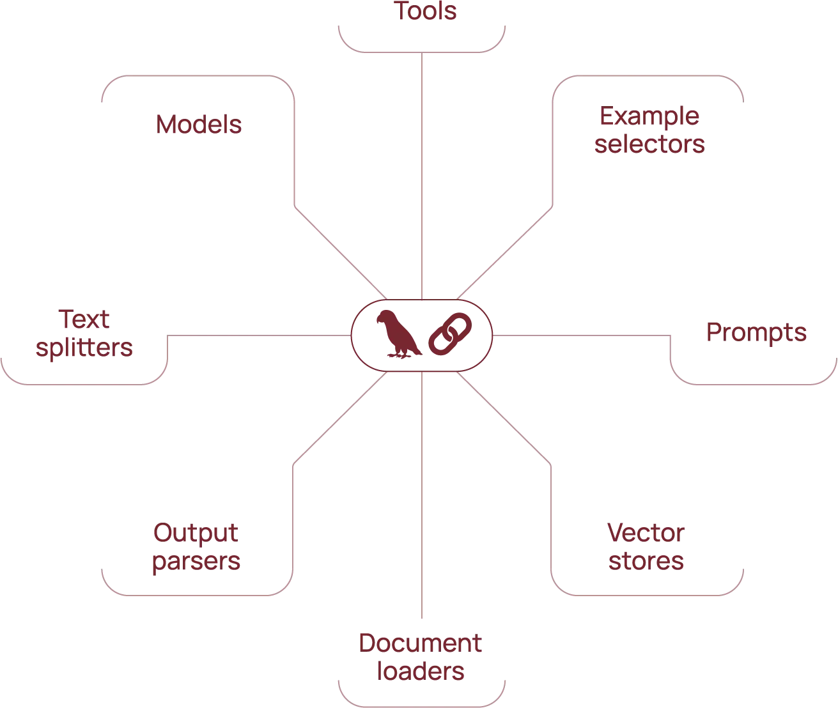
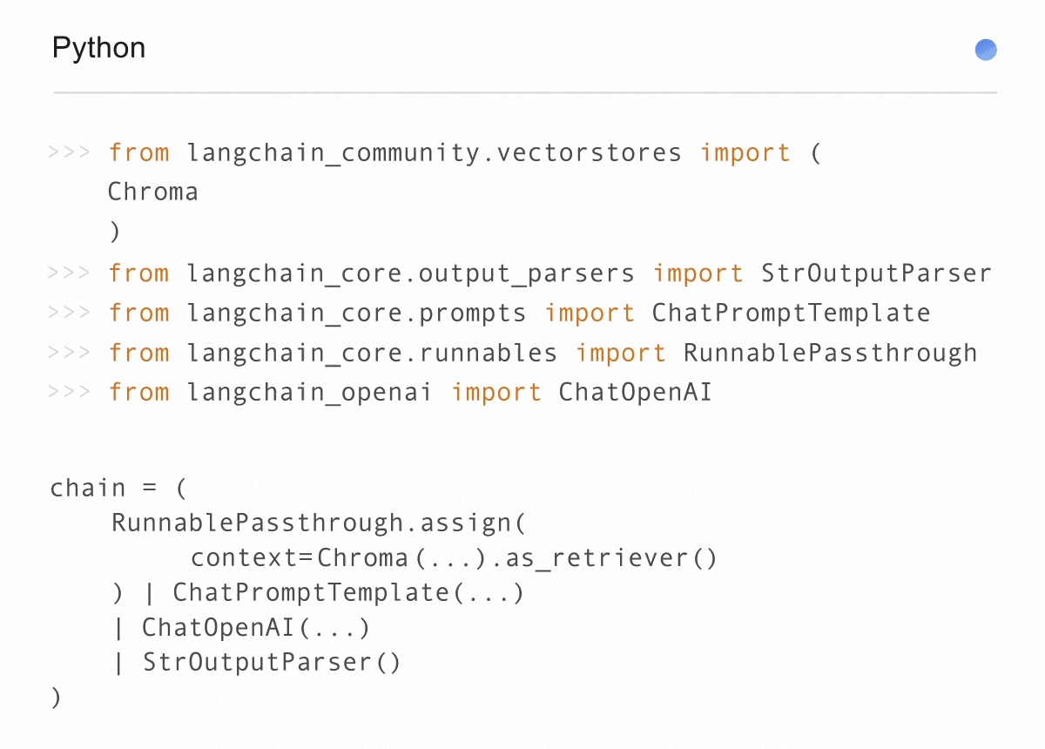
LangChain
Not long after the launch of ChatGPT in Nov 2022, a new library appeared that was focused on the integration of LLMs as a core logical processing piece that connected components together.
The library LangChain has since become the de-facto chain library for the GenAI community and now has 100s of integrations into every mainstream and opensource model.
LangChain allows developers to connect not just prompts and LLMs but also to other components, making it possible to build full applications that connect data and AI, all using a single framework and natural language as the user’s input
Notes:
https://www.langchain.com/

Slide 29
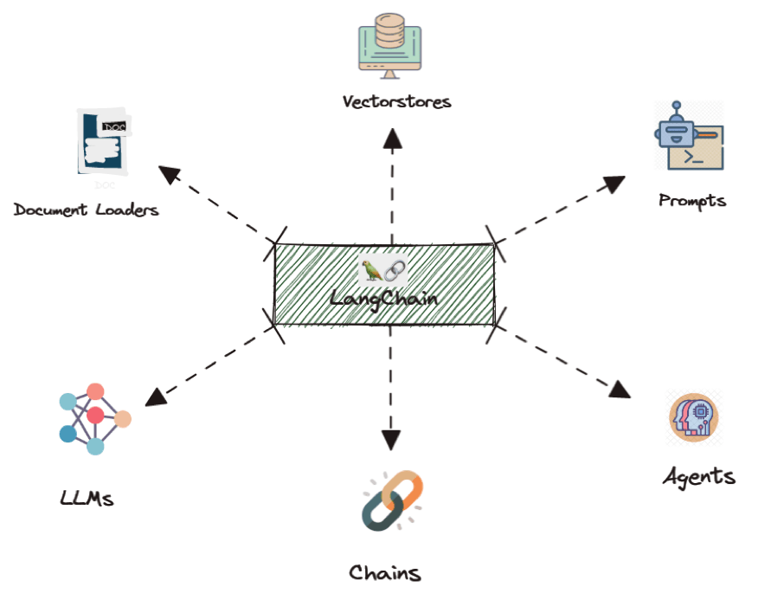
Combining LLMs with other components
With chains, we can connect more than just prompts to LLMs
We can connect data sources, other LLMs, compute environments, basically anything that has a digital interface can be connected using libraires like LangChain
In the next lesson we’ll take a deeper dive into one of the most common applications, Retrieval Augmented Generation, or RAG!

Slide 30
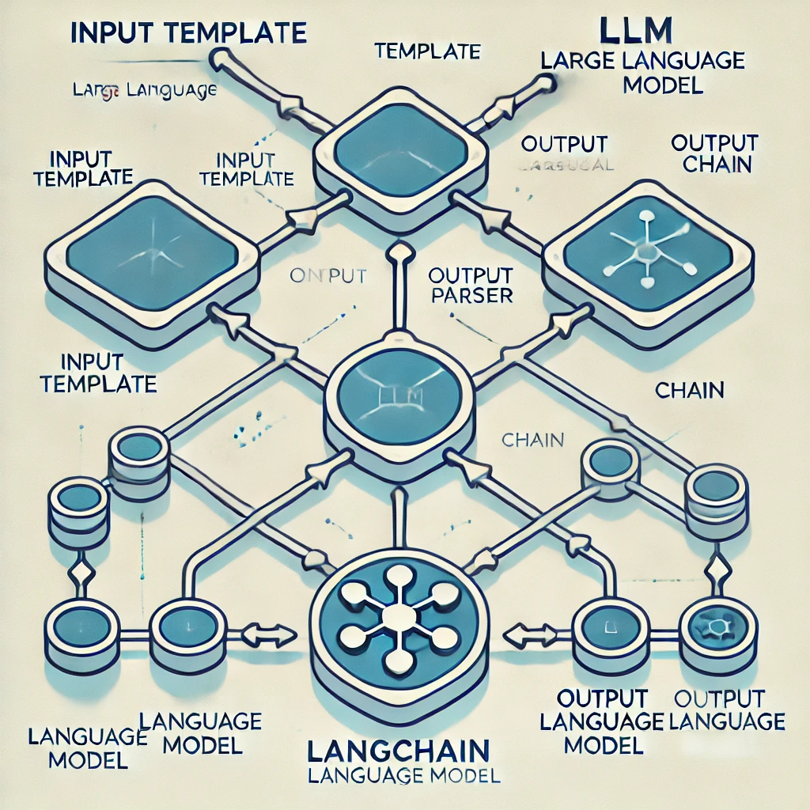
Wrap Up
LLM Components
Today we reviewed how prompts enable in-context learning
Pipelines allow us to abstract the complexities of the inner workings of transformers to make interactions easier
Explored the different types of prompting, including the system prompt
Introduced the concept of LLM chains and how the LangChain library can be used to make complex logical flows
-----------------------------------------------------------------------------
In the next lesson we will start our discussion on how to build more complex chains and LLM applications, starting with Retrieval Augment Generation.
(LangChain graph generated by ChatGPT)

Slide 31
Thank you!

